Slide 1
15CSE480 INTERNET OF THINGS
Smart Streetlight System Final Review
Student Team:
B.Navya (CB.EN.U4CSE17317) Chowdeswari (CB.EN.U4CSE17319) P.Abhiram (CB.EN.U4CSE17347)
Department of Computer Science & Engineering Amrita School of Engineering
AMRITA VISHWA VIDYAPEETHAM
Semeseter - 7

Slide 2
Problem Definition
We aim to develop Smart city solutions by modernizing the street lighting system by using Internet of things to ease the process and make it environmentally friendly.

Slide 3
Literature Review
The aim of automated streetlight management system using IOT is the conservation of energy by reducing electricity wastage as well as to reduce the manpower. Streetlights are the elemental part of any city since it facilitates better night visions, secure roads, and exposure to public areas but it consumes a quite large proportion of electricity. In the manual streetlight system lights its powered from sunset to sunrise with maximum intensity even when there is sufficient light available. This energy wastage can be avoided by switching off lights automatically. The saved energy can be efficiently utilized for other purposes like residential, commercial, transportation etc. This can be achieved using an IOT enabled streetlight management system. The project uses Light Emitting Diodes (LED) that do not consume an enormous amount of electricity to replace the power consuming traditional HID lamps.

Slide 4
Literature Review
Disadvantages of Existing System:
Manual Switching off/on of Street Lights
More Energy Consumption.
High expense.
More manpower.
Advantages of the Proposed System:
Automatic Switching of Street lights.
Maintenance Cost Reduction.
Reduction in CO₂ emission.
Reduction of light pollution.
Wireless Communication.
Energy Saving.
Reduction of manpower.

Slide 5
Hardware Design
ESP8266 NodeMCU is an open source IoT platform.It includes firmware which runs on the low-cost Wi-Fi enabled ESP8266 Wi-Fi SoC from Espressif Systems, and hardware which is based on the ESP-12 module. It has GPIO, SPI, I2C, ADC, PWM AND UART pins for communication and controlling other peripherals attached to it. On board NodeMCU has CP2102 IC which provides USB to TTL functionality.

Slide 6
Sensors & Actuators identified
IR Sensor
IR sensor is an electronic device which is used to detect objects by sensing infrared radiations reflected from the objects. It mainly consists of a transmitter IR LED and a receiver photodiode. When a specific positive voltage is applied across the transmitter LED it transmits the IR rays. If these rays fall on some object, then that object reflects back the IR rays which are received by the receiver photodiode. The receiver diode generates a voltage across its terminals which depend on the intensity of light reflected by the object.

Slide 7
Sensors & Actuators identified
LDR Sensor
LDR stands for Light Dependent Resistor also known as photo-resistor. LDR is sensitive to light and its resistance changes according to the intensity of light falling on it. When light incident on the LDR exceeds some threshold, it absorbs the photons and allows electrons to jump into the conduction band. LDR generates a variable resistance which depends on the intensity of light falling on it. It is mainly used in electric circuits like streetlights, alarm clocks, automatic brightness and contrast control etc.

Slide 8
Justification for Sensors & Actuators selected
We decided to use IR proximity Sensor compared to the other available sensors like ultrasonic proximity sensors and capacitive proximity sensors by considering factors like cost, performance over a long distance, suitability to detect complex objects.
We chose LDR Sensor compared to photodiode taking into consideration the cost and the fact that LDR can vary the light depending on the environments lighting conditions as compared to a photodiode which can only turn it on or off.

Slide 9
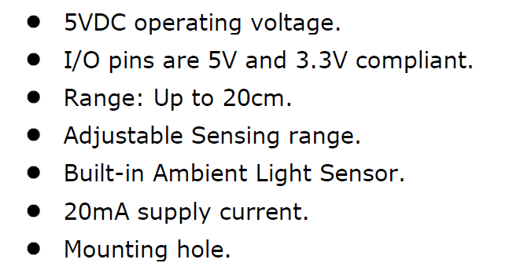
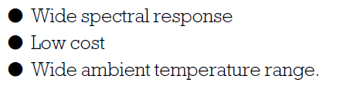
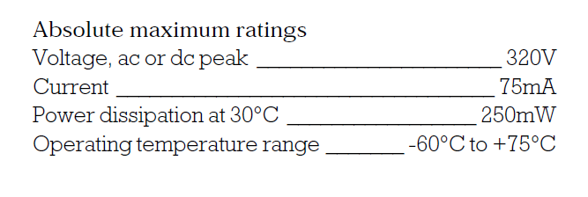
Specification of the Sensors & Actuators
IR Sensor
LDR Sensor

Slide 10
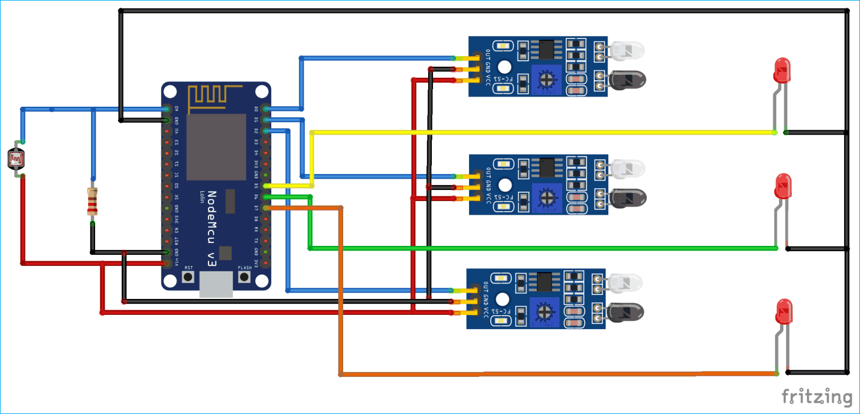
Schematic Diagram

Slide 11
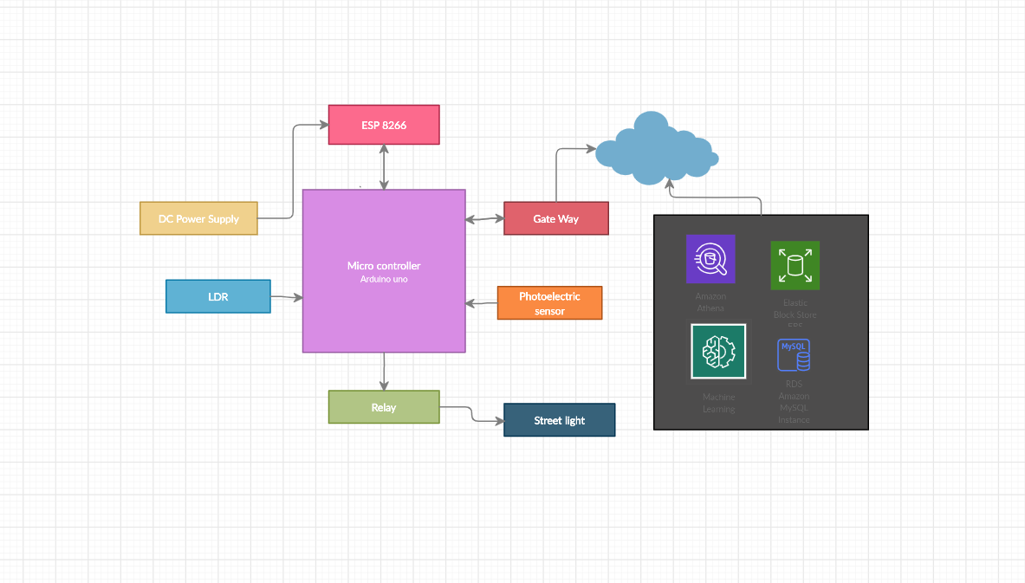
Software Design
Block diagram

Slide 12
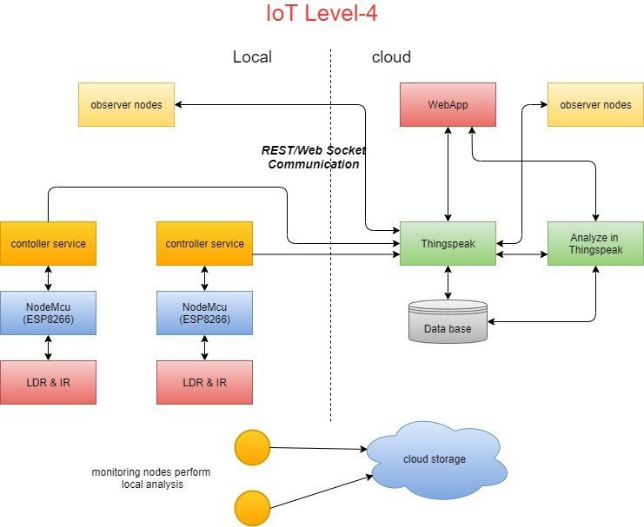
Software Design
Architecture diagram

Slide 13
Software Design
We choose IOT level-4 for automatic street light because the system consists of multiple nodes placed in different locations for monitoring lights in an area
The nodes in this project are equipped with photoelectric sensors .
Nodes are independent of each other. Each node runs its own controller service that sends data to the cloud. The data is stored in a cloud database
The Analytics of data collected from number of nodes is done in the cloud. A cloud based application is used for visualizing the aggregated data

Slide 14
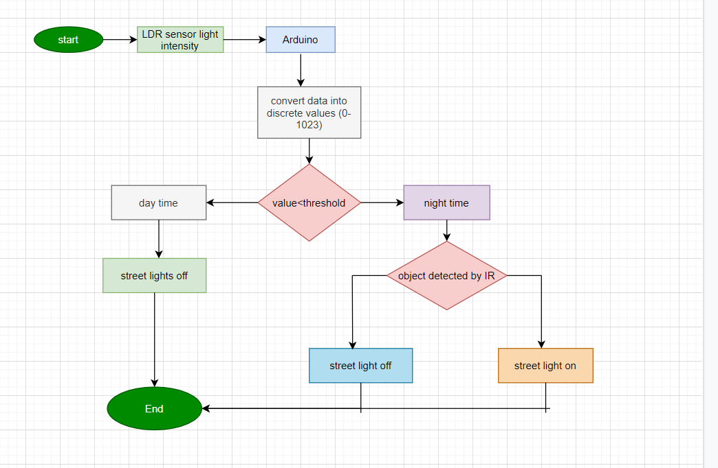
Software Design
Data Flow diagram

Slide 15
Important Features:
Energy saving
Object detection
Turn street light off in day light
Turns street light on in night time
Further improve electricity saving by switching on lights in night only when vehicles detected.
Help in providing accurate speed limits.

Slide 16
Conclusion
We were able to develop a perfectly working and executable model of the proposed system and have also added in a feature to help approximate the best speed limit for each road by measuring speeds to improve road safety. We are able to save a substantial amount of electricity especially in roads which are not widely used where lots of electricity is wasted though the roads are deserted. By using LED lights and our system which is a part of the smart city innovative system can help the environment by saving electricity and also improve road safety substantially.

Slide 17
DEMO
YouTube link for the Demo:
https://www.youtube.com/watch?v=389HUbqBD5c&feature=youtu.be

Slide 18
References
https://ieeexplore.ieee.org/document/8326023
https://www.researchgate.net/publication/323280626_Internet_Of_Things_Based_Intelligent_Street_Lighting_System_for_Smart_City
https://ieeexplore.ieee.org/document/8326023

Slide 19
THANK YOU

